Slide 1

Movie Theater Database
Thomas Simmons, Aidan Lee, Nicholai Platonoff
December 3, 2024
DS 5110

Slide 2
Introduction
Objectives & goals
Project scope

Slide 3

Objective & Goals
• Designing a comprehensive relational database to model the operations of
a movie theater
• Generating realistic datasets for analysis, including the application of var-
ious statistical distributions to simulate real-world scenarios.
• Writing a variety of SQL queries to extract actionable insights, such as
identifying popular movies, tracking revenue, and etc.
• Exploring advanced reporting techniques, including Power BI visualiza-
tions, to present findings in an accessible and impactful manner

Slide 4
Literature Review

Slide 5
Literature Review
Existing Research
Focuses on database design, data generation, analytics, and visualization for movie theaters
Relational models (Codd, 1970) support structured data management (movies, customers, tickets, schedules)
Identified Gaps
Domain-specific applications
Scalability and real-time data
Focus of the Project
Create frameworks for database design, analytics, and visualizations
Incorporate advanced analytics findings and results to improve theater operations

Slide 6
Methodology

Slide 7

Methodology Steps
ERD Diagram
Dataset Generation
SQL Querying
Visualization

Slide 8
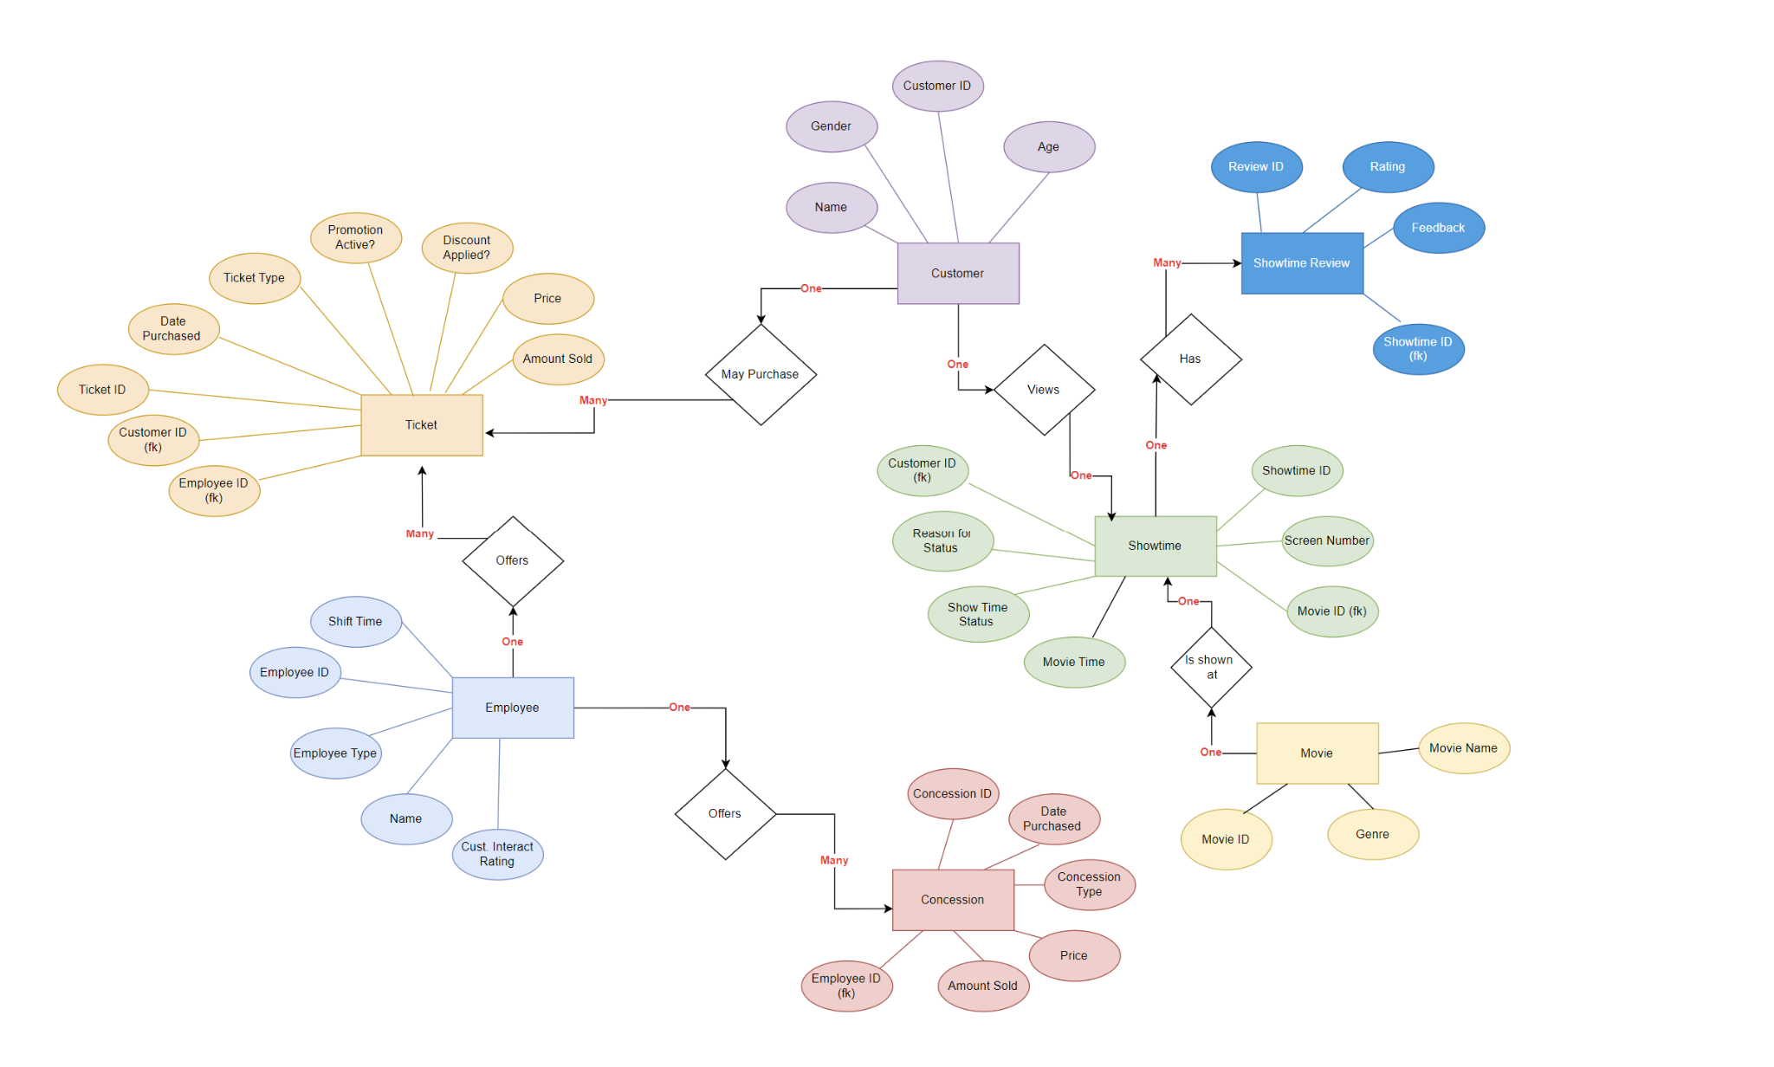
ERD
- Tables
Customer
Ticket
Employee
Concession
Movie
ShowTime
ShowTime Review
- Relationships

Slide 9
Dataset Generation
Tools involved: Python + Faker Package
Generated 7 Tables
ERD Reference
Distribution weights were applied
Columns: Age, Screen Condition, and etc
Employee and Movie have 30 - 120 row entries
Concession, Customer Data,Ticket, ShowTime Review and ShowTime Data have entries > 10,000

Slide 10
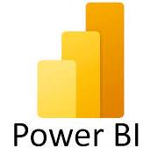

Querying + Visualizations
Run Queries on Movie Theater Database
Export SQL Query Results to CSV
Import CSV to Tableau / Microsoft Power BI
Generate Visual Graphics Based on Asked Questions
Identify Most Visual Impactful Graphics
Export Graphics to Report and Presentation

Slide 11
Demos - SQL & PowerBI

Slide 12
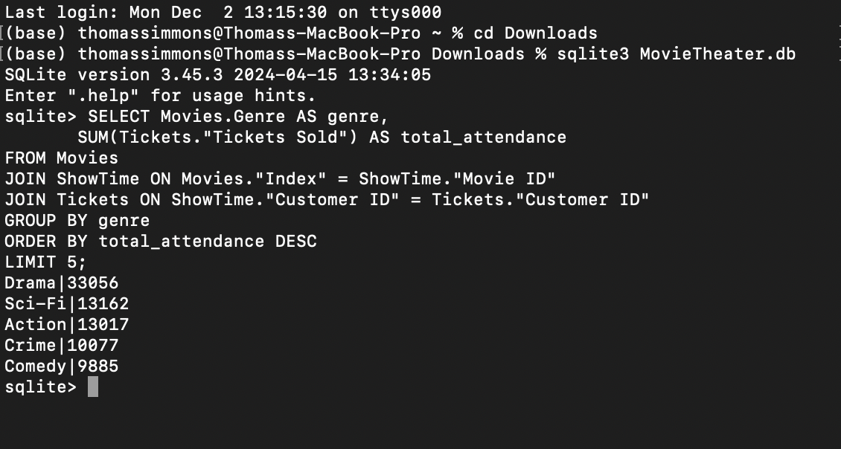
SQL Demo (1 of 2)

Slide 13
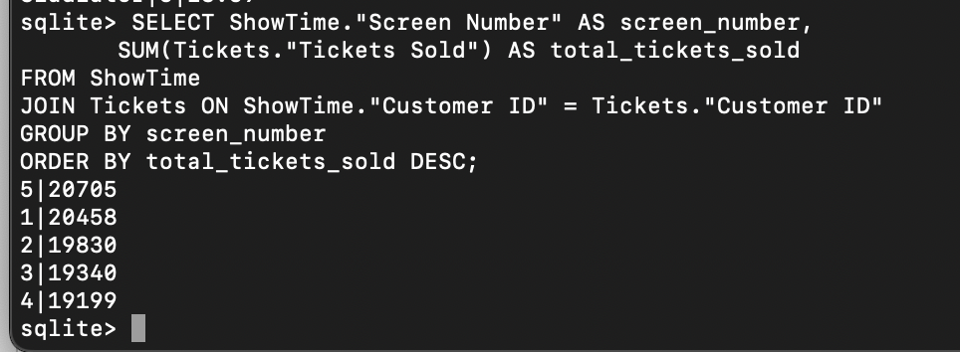
SQL Demo (2 of 2)

Slide 14
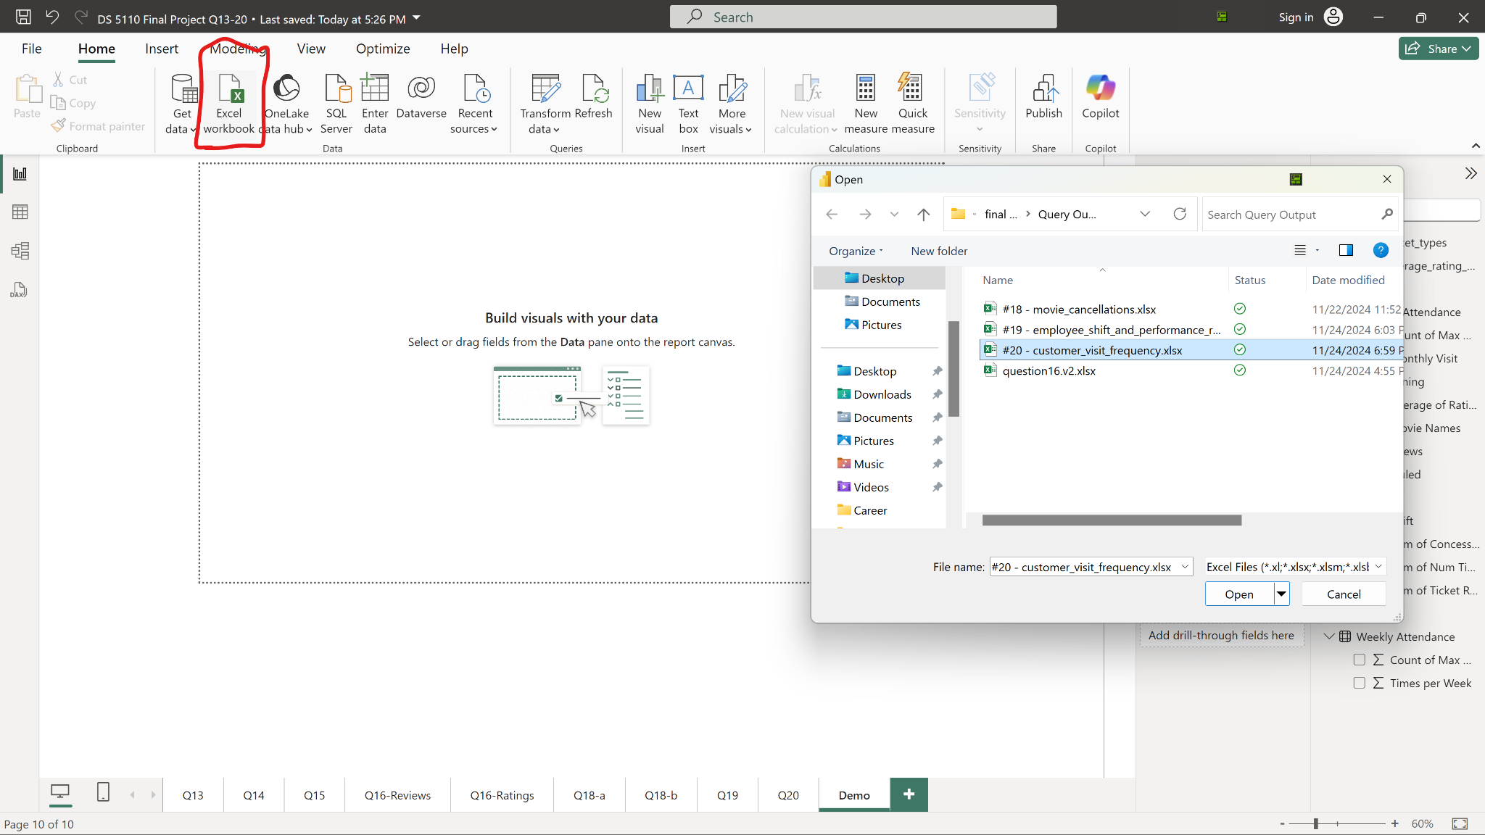
Power BI Demo (1 of 3)

Slide 15
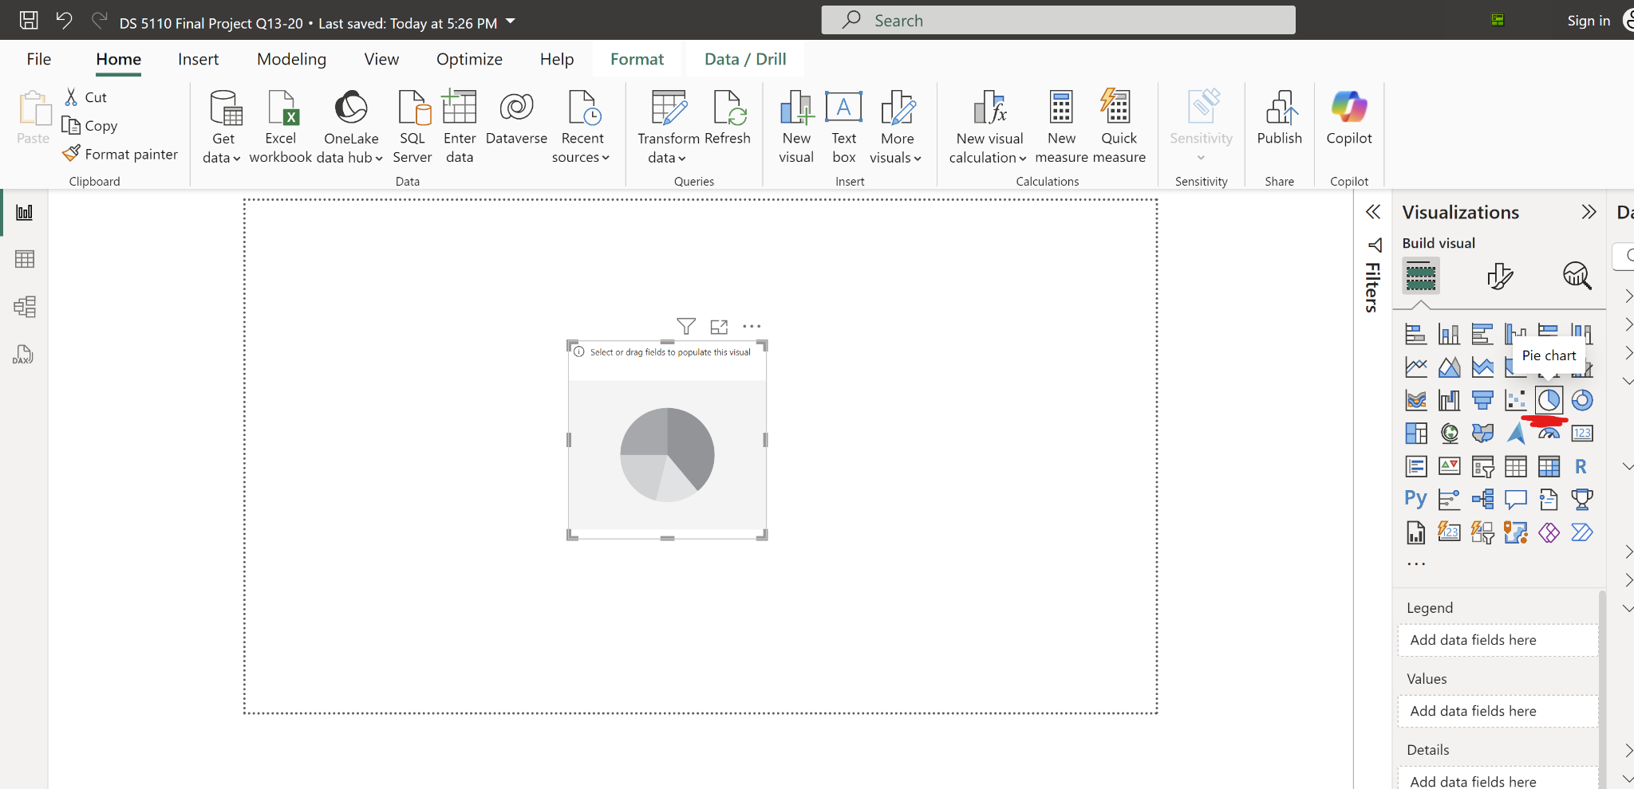
Power BI Demo (2 of 3)

Slide 16
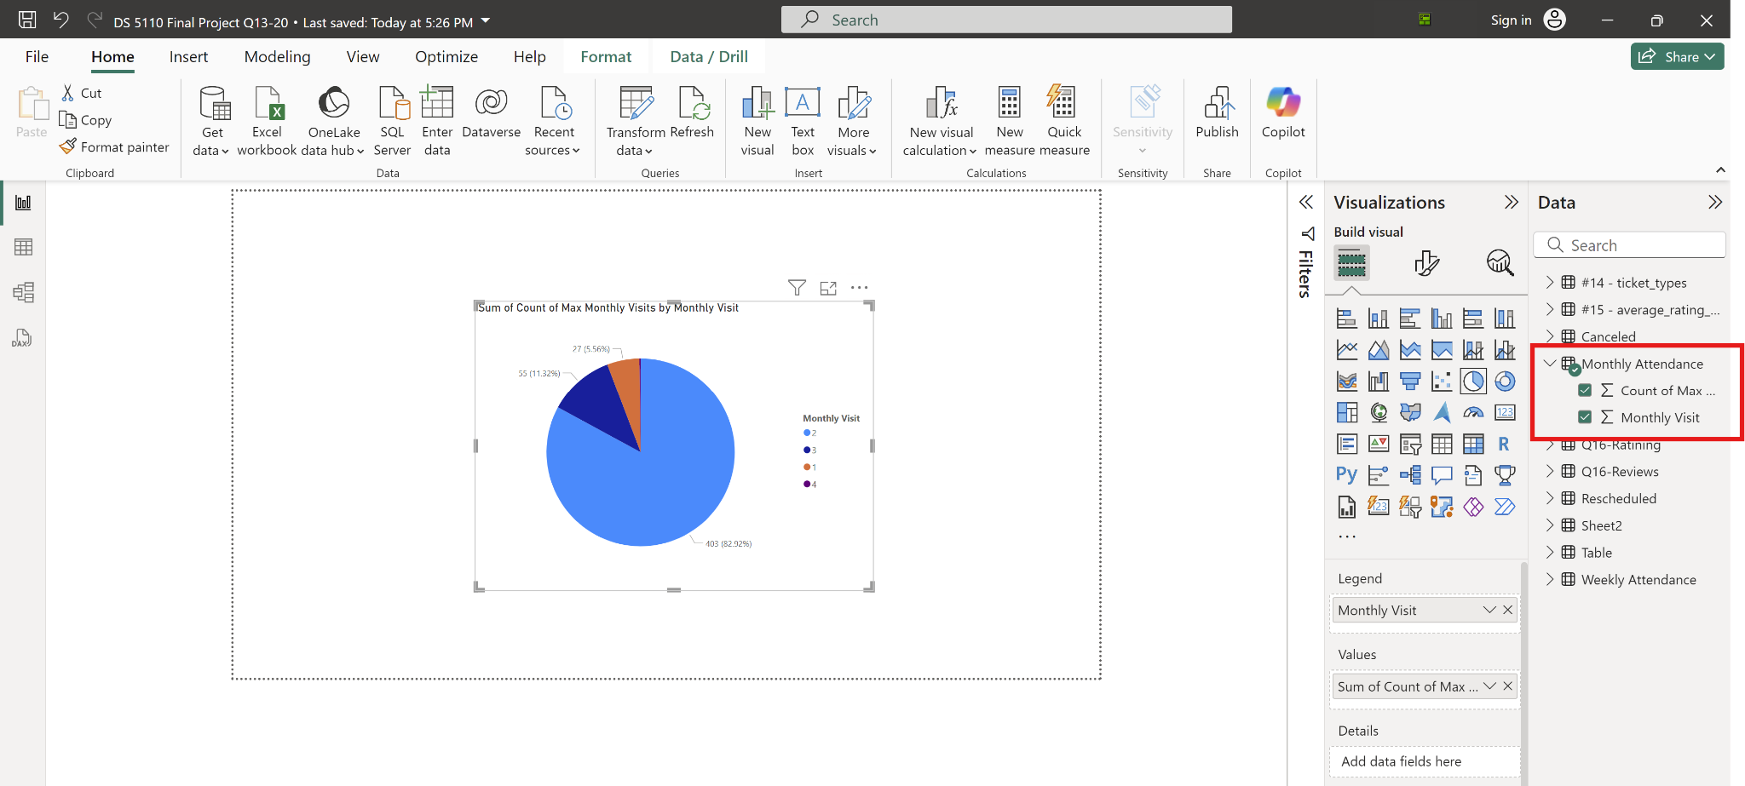
Power BI Demo (3 of 3)

Slide 17
Analysis & Results

Slide 18
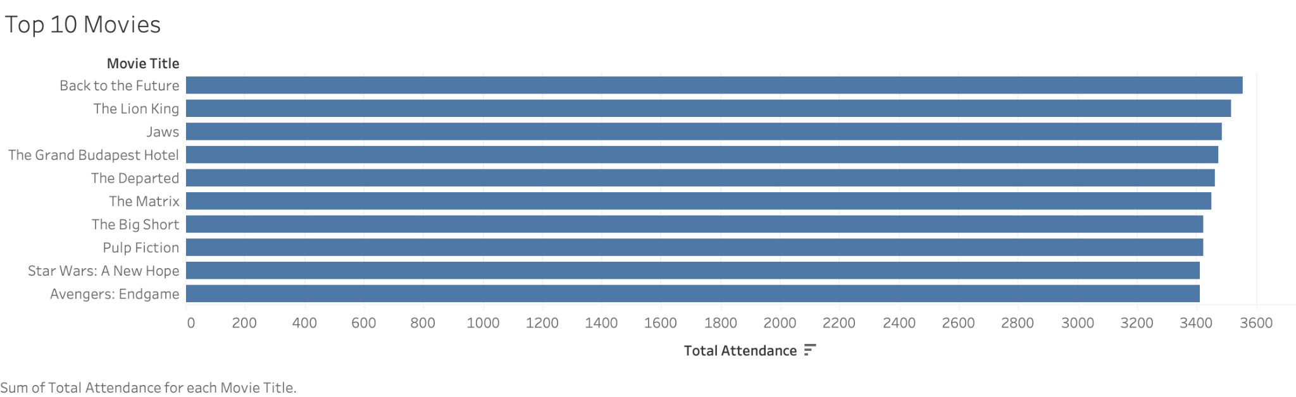
Top 10 Movies

Slide 19
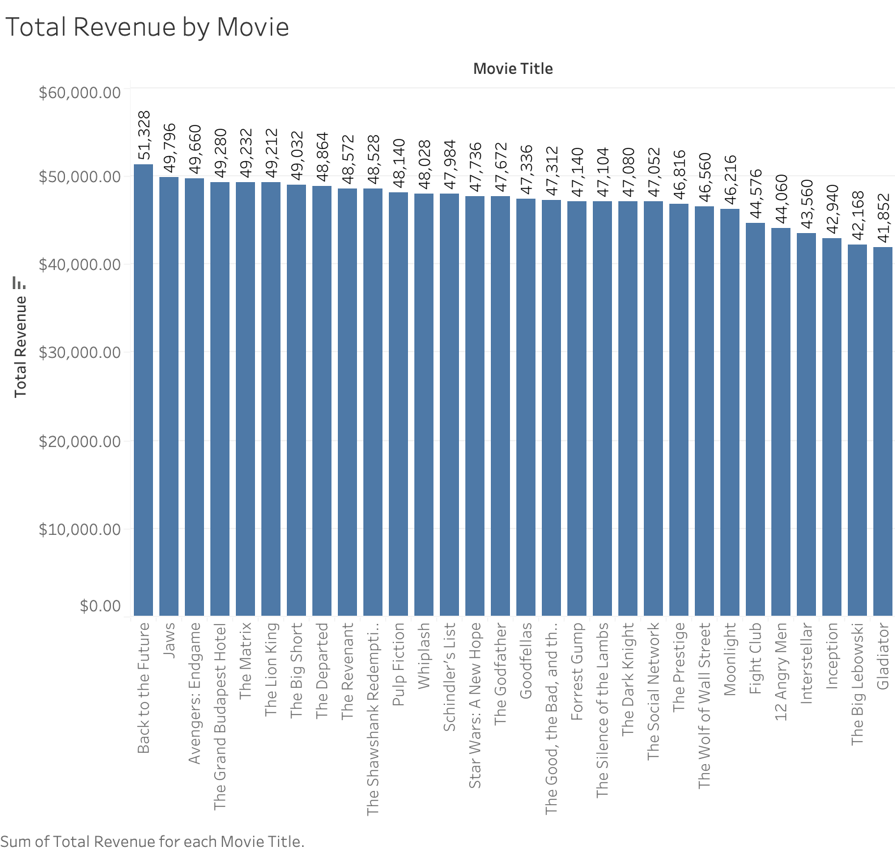
Total Revenue by Movie

Slide 20
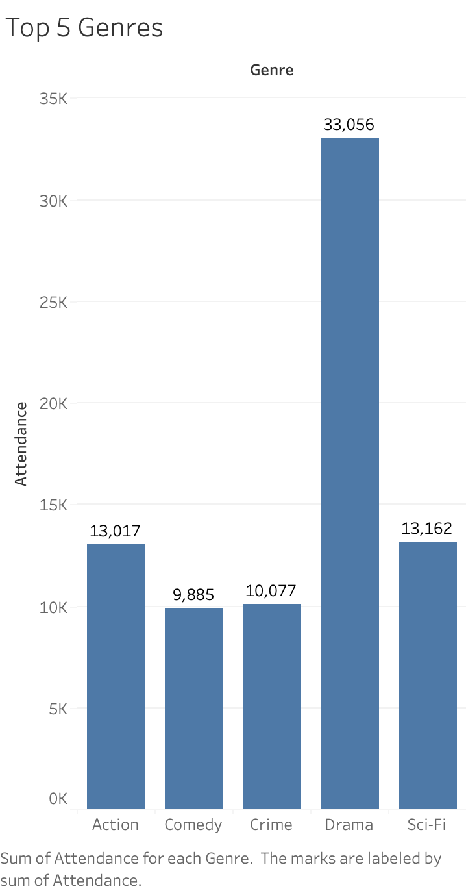
Top 5 Genres

Slide 21
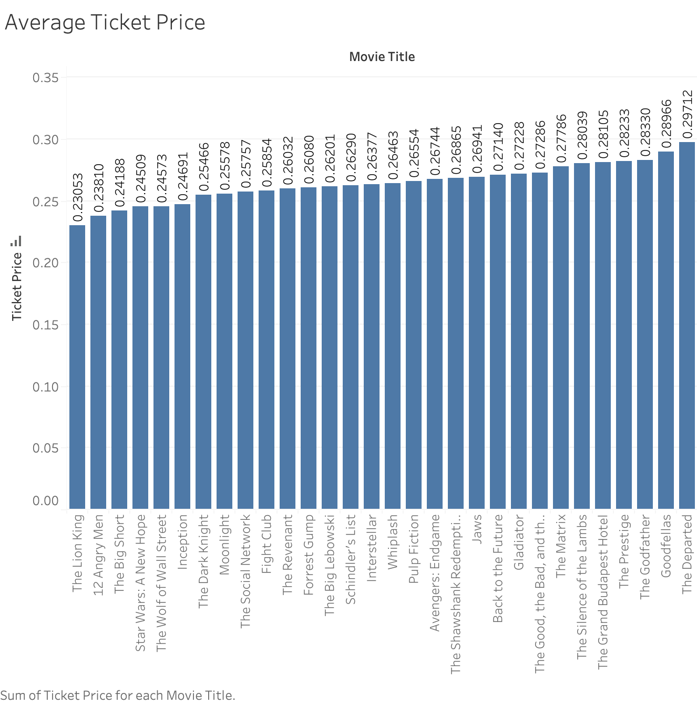
Average Ticket Price

Slide 22
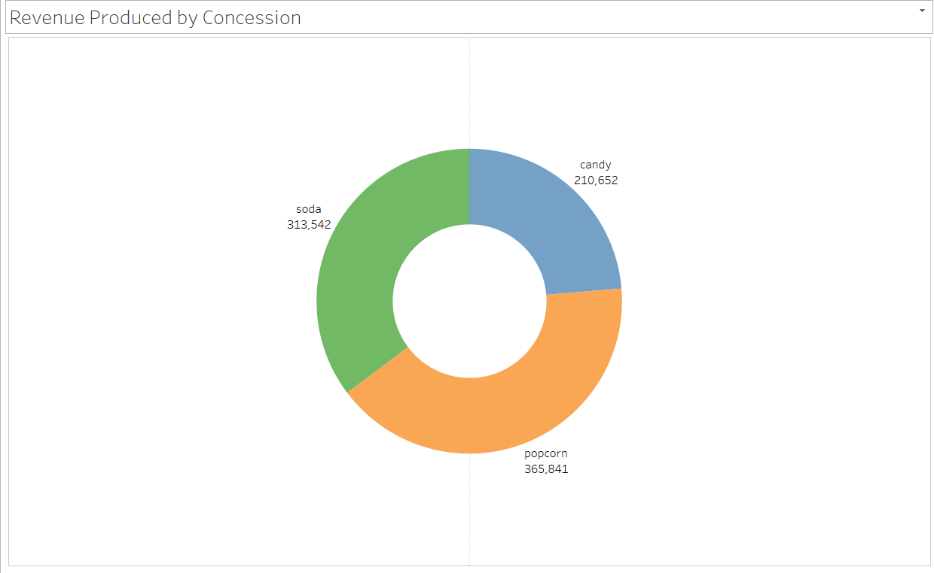
Concession Revenue

Slide 23
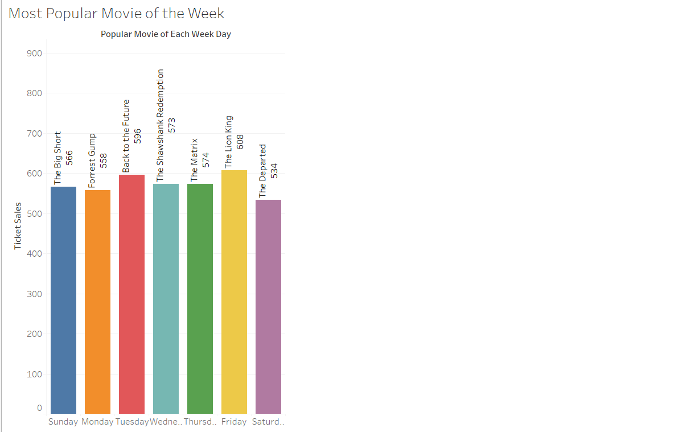
Most Popular Movie

Slide 24
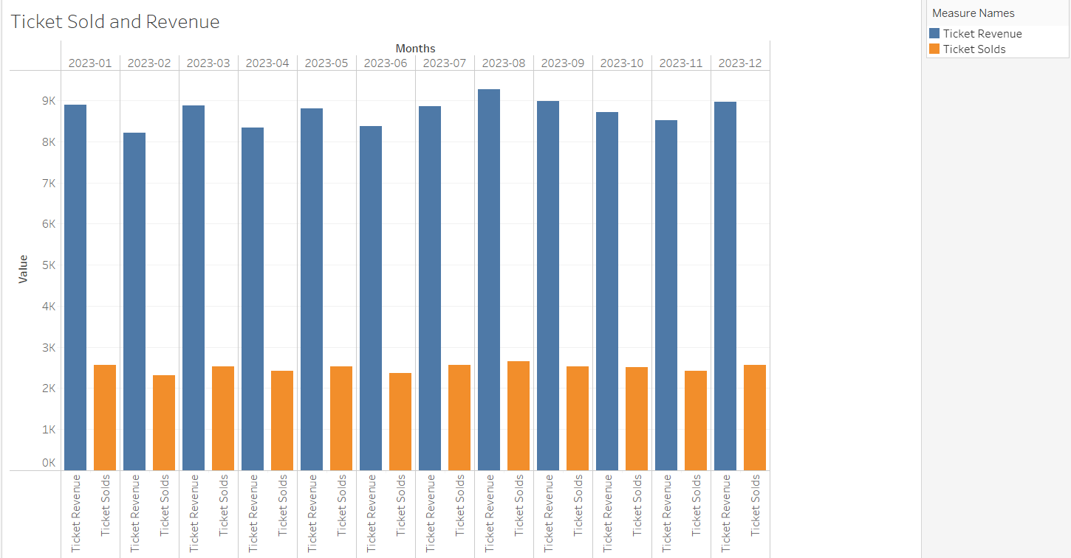
Monthly Revenue

Slide 25
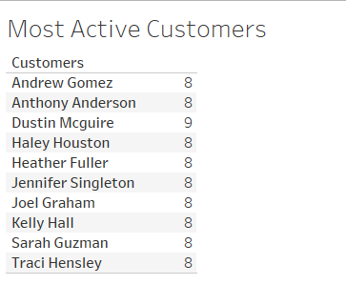
Frequent Customers

Slide 26
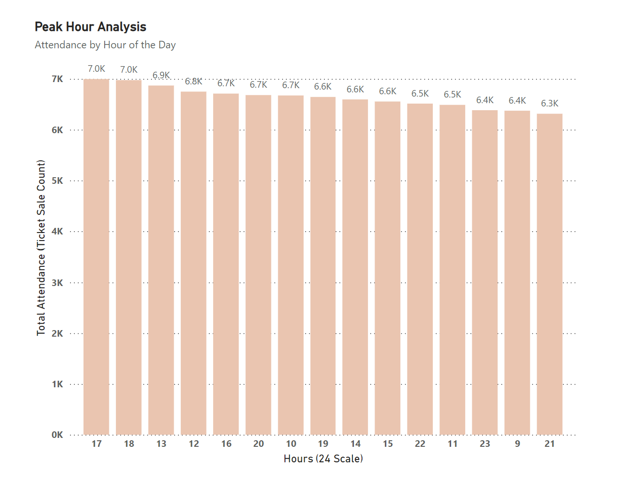
Peak Hour Analysis
The most busy time was the 17th hour of the day (5pm). Over the year, seven thousand people attended the theater at that time.

Slide 27
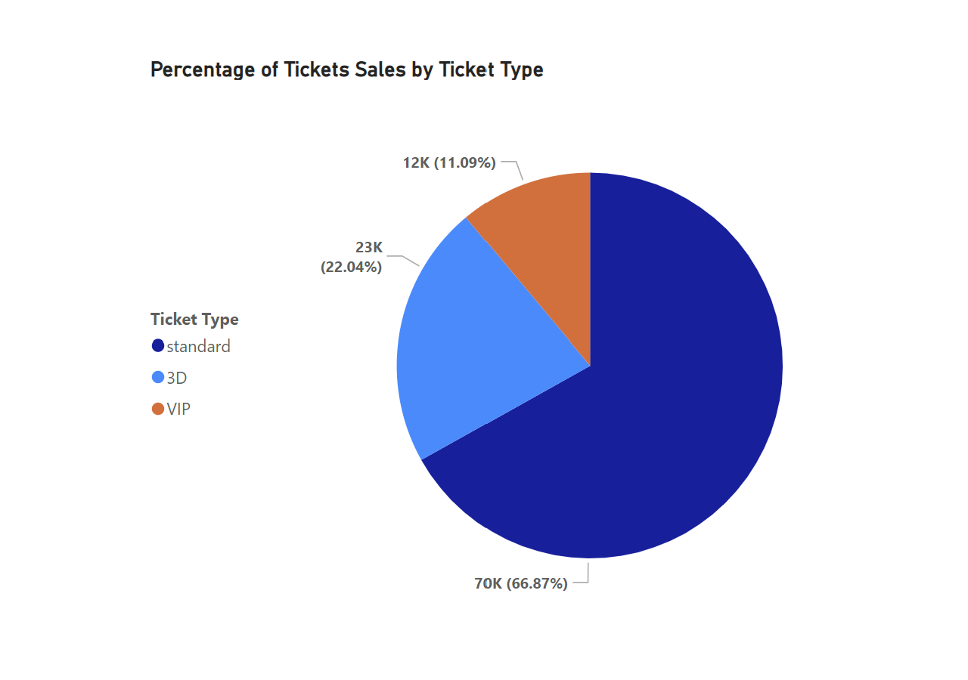
Ticket Sales by Type
Standard Tickets accounted for 66%(70k), 3D at 22% (23k), and VIP at 11% (12k) of total sales

Slide 28
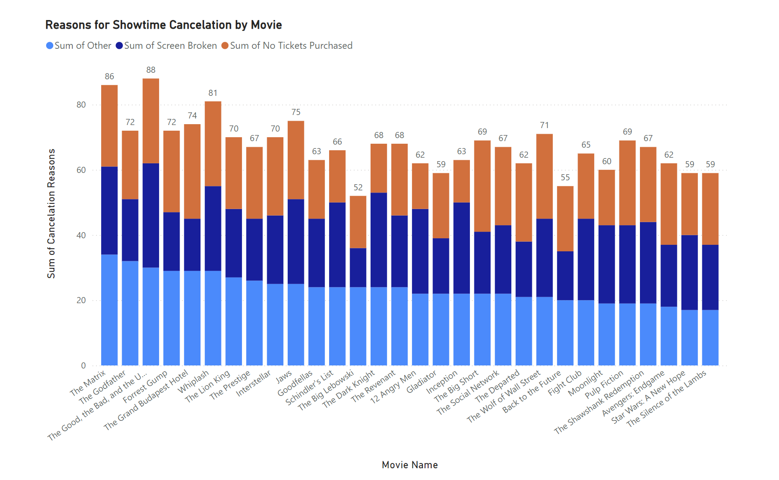
Showtime Cancellations
Sometimes the theater needed to cancel a showing of a movie. The reasons marked: (Screen Broken, No Tickets Purchased, and Other)
We also analyzed why some showings were rescheduled.

Slide 29
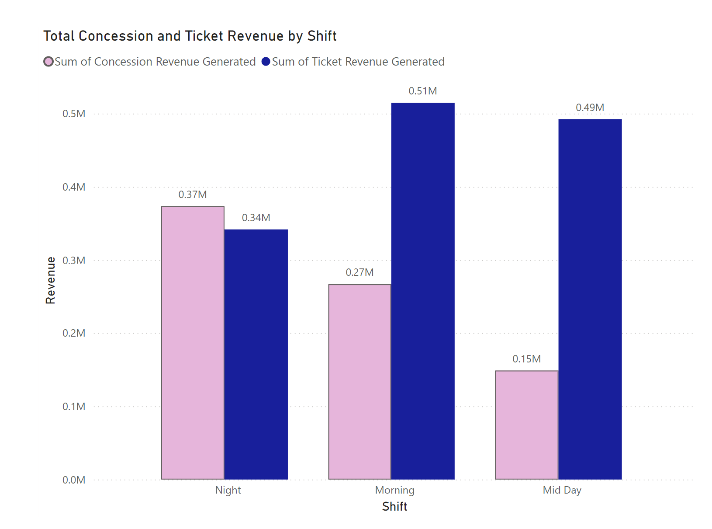
Concession and Ticket Revenues by Shift
The shift performance was tracked by total concession and total ticket sales.

Slide 30

Conclusion
Analytical insights
Audience behaviors
Revenue optimization
Operational efficiencies
Identified unique trends in data
Week day attendance
Performance of genres
Improvements
Limitations of dataset
External factors
Weather
Use of advanced predictive modeling techniques

Slide 31
Thank you for your time!

